Slide 1
DRC Summary (1.Violation item, 2.DRC report summary, 3.Image snap shot 4.Error explanation)

Slide 2
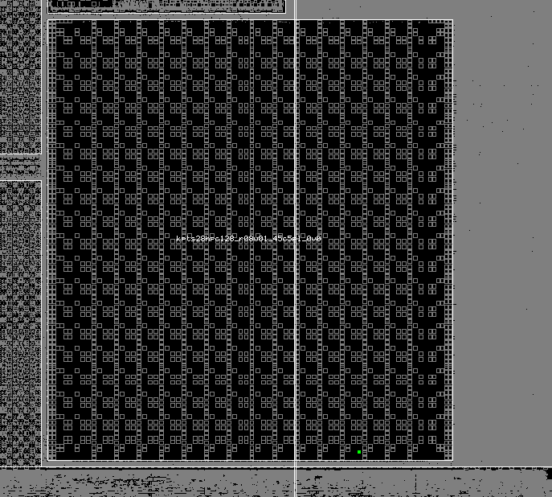
PO.R12
Width of {{PO OR SR_DPO} INTERACT same OD} must be the same [OUTSIDE OD2, channel length < 0.15 um](This check doesn't include the regions covered by SR_ESD, and SDI.
Waived by OTP vendor.

Slide 3
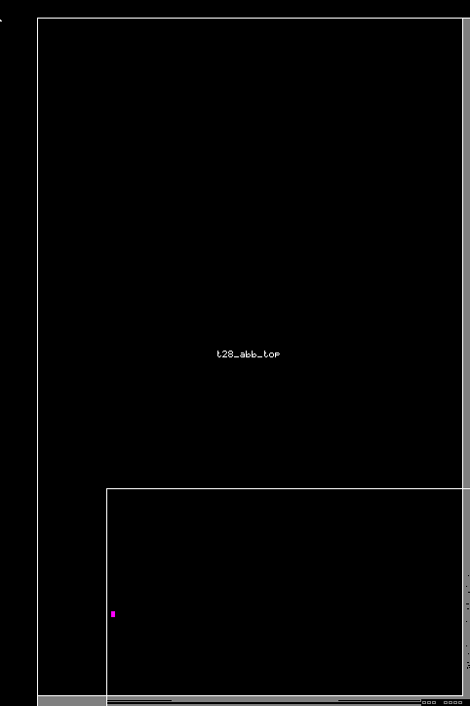
ESD.7g
xcept the ESD device, either one of the following two conditions must be followed.
@ 1. the space of two same type ODs >= 1.2 um 2. two same type ODs should be separated by different type OD.
Waived by Artosyn.

Slide 4
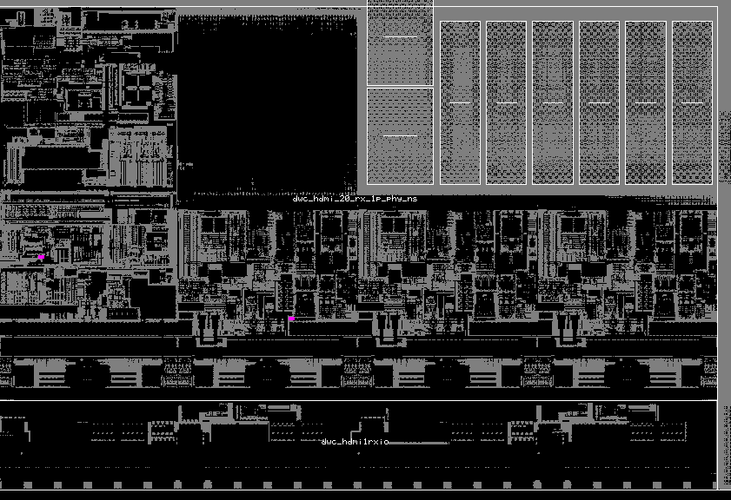
ESD.18g
Total finger width for NMOS in same connection of drain > 360 um.
Waived by Synopsys.

Slide 5
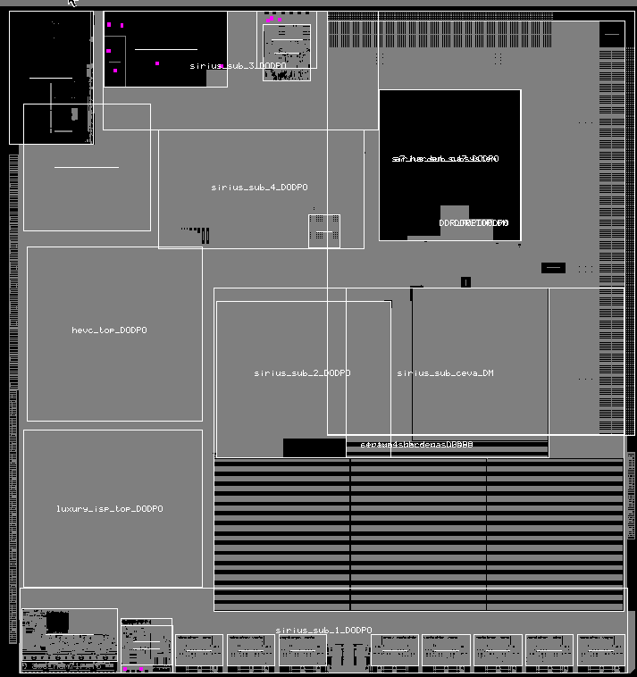
HIA.3g
Total perimeter of each N+ or P+ ACTIVE inside HIA_dummy in same connection of I/O PAD. (Figure XXX and Figure XXX). The perimeter counts the drawn anode junction parameter region ex. The drawing OD perimeter dimension of active inside HIA_DUMMY= (A+B)*2*N >= 300.
Waived by Cadenc & Synopsys

Slide 6
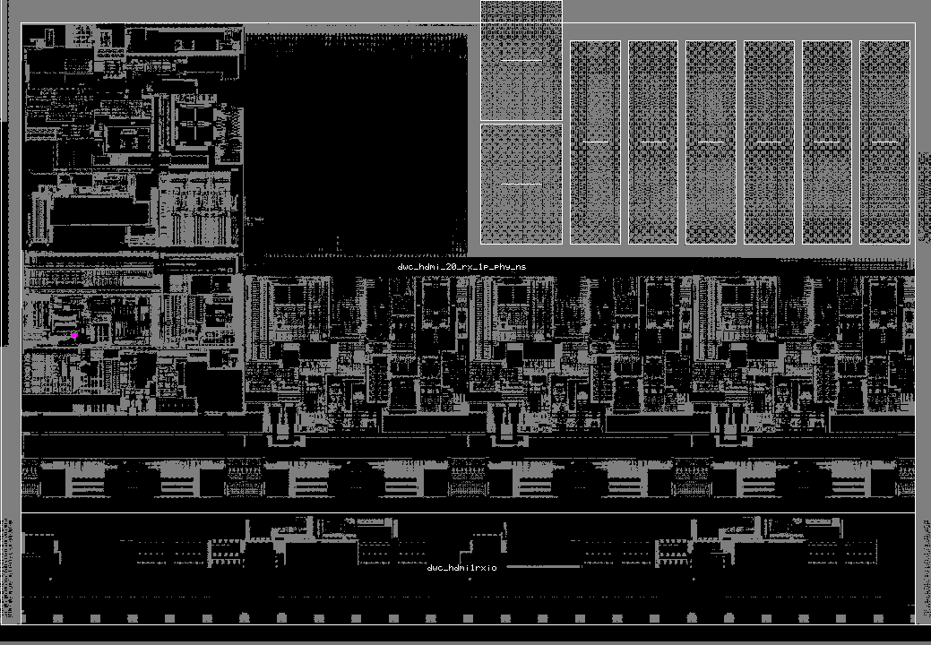
ESD.3g
Unit finger width of NMOS and PMOS for I/O buffer and Power Clamp >= 2 um <= 29 um.
waived by Synopsys.

Slide 7
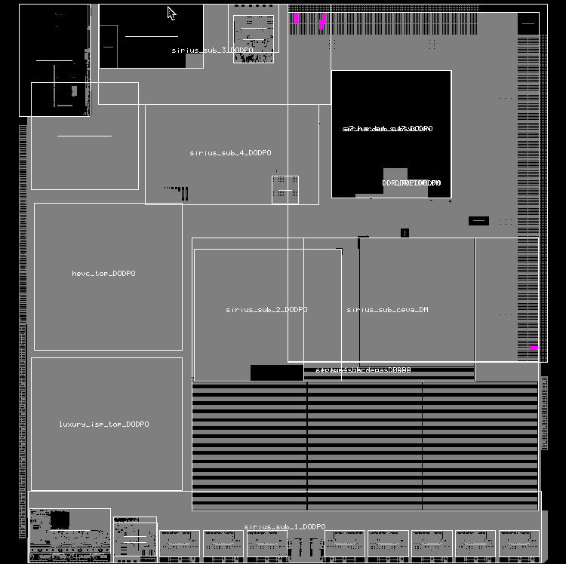
ESD.6g
Butted STRAP and the STRAP which are between two sources of the N/PMOS in the same I/O buffer and Power Clamp are strictly prohibited. waived by Synopsys.

Slide 8
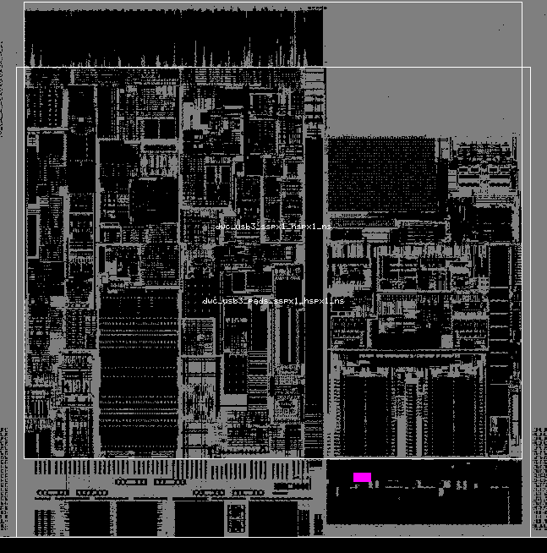
ESD.31g
Overlap of RPO on the drain side to the poly gate for NMOS HV Tolerant I/O == 0.06 um waived by Synopsys.

Slide 9
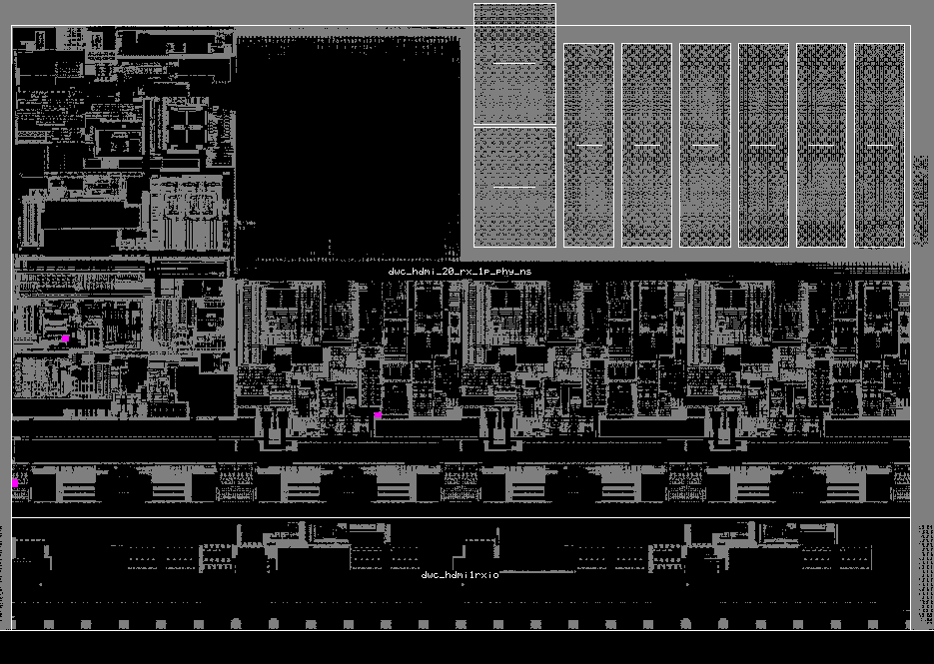
ESD.52g
Big MOS of RPO type Power Clamp is strongly recommended has ESDIMP
waived by Synopsys.

Slide 10
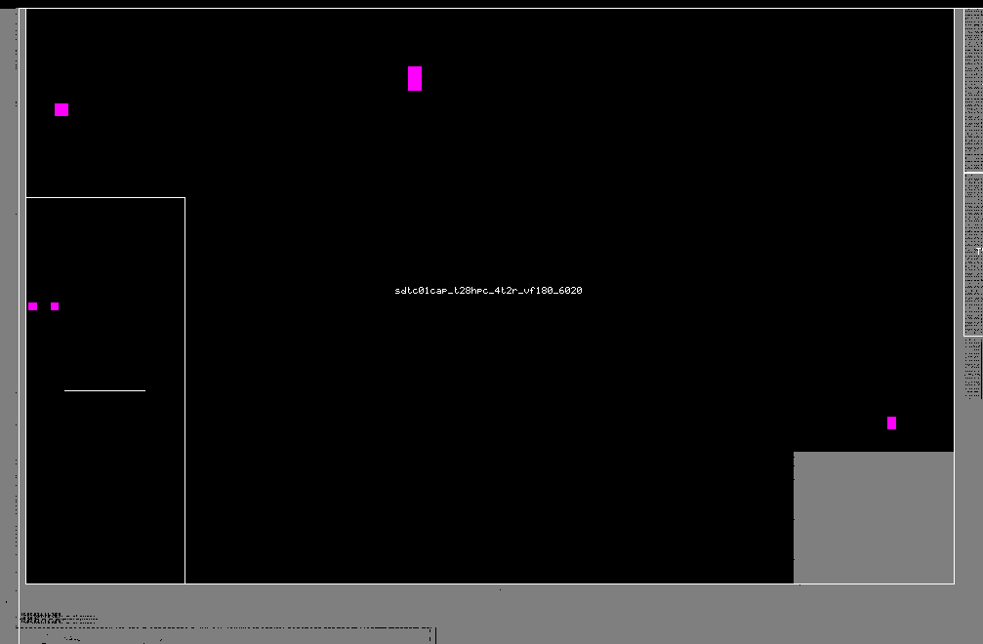
HIA.4g
The OD spacing of longer side of anode (P-diode) between anode and cathode, and vice versa for (N-diode). = 0.15~0.4
waived by Cadence.

Slide 11
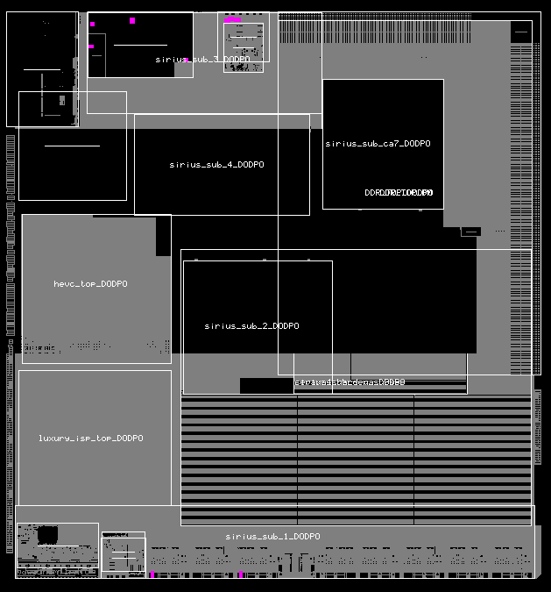
HIA.5g
The OD spacing of shoter side of anode (P-diode) between anode and cathode, and vice versa for (N-diode). = 0.3~0.8
waived by Synopsys & Cadence.

Slide 12
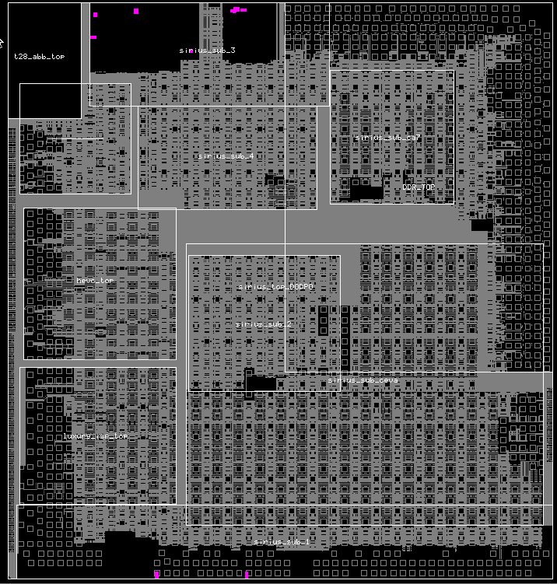
HIA.5g
The OD spacing of shoter side of anode (P-diode) between anode and cathode, and vice versa for (N-diode). = 0.3~0.8
waived by Synopsys & Cadence.

Slide 13
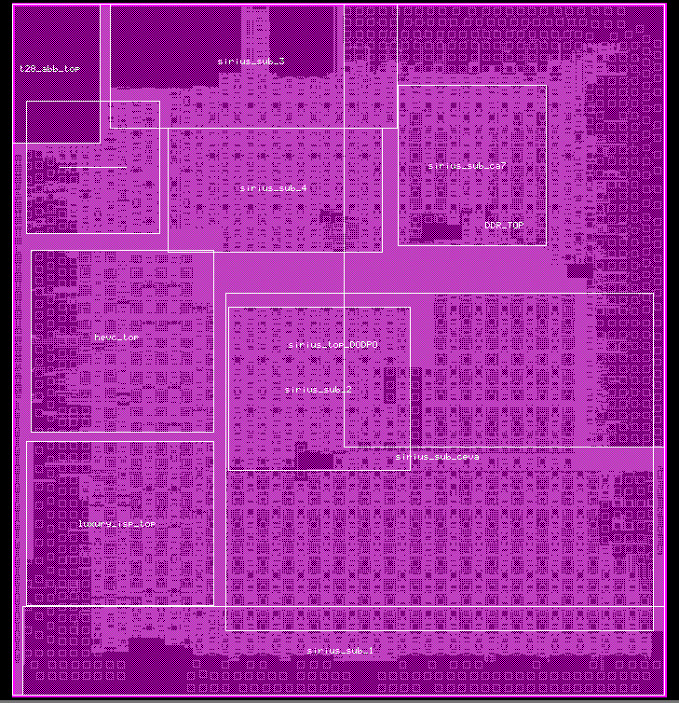
IO_CONNECT_CORE_NET_VOLTAGE_IS_CORE:WARNING1;
DIODMY_L:WARNING; SRAM.WARN.1 ;MFU.R.1

